Slide 1

Wedding Planners Analysis
By
Shweta R Nikate

Slide 2
About me
My name is Shweta Ravindra Nikate, I have completed my BE in Ceramics and Cement Technology from PDA Engineering College, Gulbarga, Karnataka.
I am learning Data Analytics because data has become a key factor in decision-making across every industry. It helps me to solve real-world business problems, and build a stable, impactful career in a rapidly growing field.
Work experience: I worked as a Pre-Sales Executive nearly about 3 years and worked as a Admin & HR executive for about 6 months.
LinkedIn: www.linkedin.com/in/shweta-nikate-220202330
GitHub: https://github.com/ShwetaNikate

Slide 3
Objective
To analyze data of wedding planners scraped from WedMeGood website.
Clean and Structure Raw Web-Scraped Data.
Understand Market Distribution of Wedding Planners.
Evaluate Planners Based on Performance Metrics.
Explore Relationship Between Reviews & Ratings.
Assist Users in Decision Making.
Create Visual Dashboards for Insights.

Slide 4
Web Scraping Process
Sending Request & Fetching Data
Selecting Website
(https://www.wedmegood.com)
Importing Libraries
(Requests, Beautifulsoup & Pandas)
Extracting Table Data
Converting Data into DataFrame
Cleaning & Formatting Data
Save & Analyse Data

Slide 5
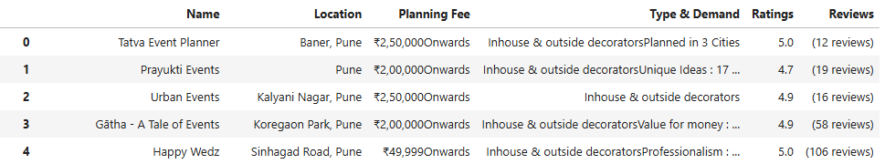
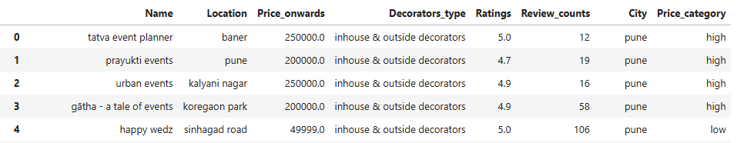
Before Cleaning the data
After Cleaning the data

Slide 6
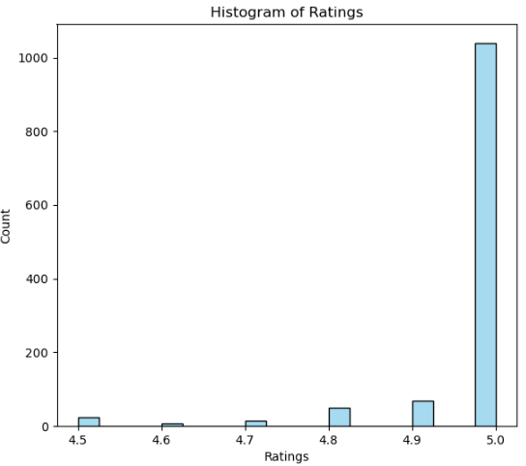
Ratings Distribution
Most planners have very high ratings ie 5.0
Ratings are heavily concentrated between 4.8 and 5.0
Very few planners have ratings below 4.5
This shows strong overall service quality
Customers are largely satisfied with wedding planners

Slide 7
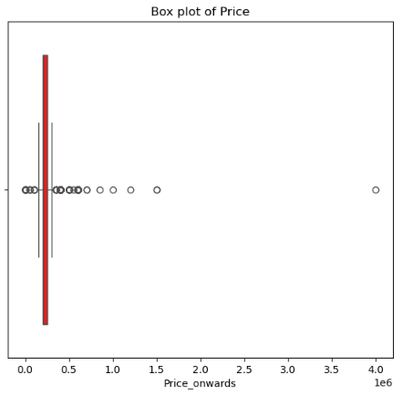
Price Distribution
Pricing is mostly concentrated in the low-to-mid range (~72%).
Only a small portion of planners charge premium prices (~22%).
This indicates a budget-sensitive market.
Customers prefer affordable planners over premium ones.
The market is moderately priced with limited premium options.

Slide 8
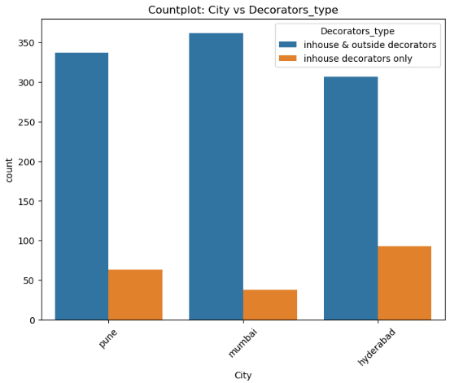
City vs Decorators type
In-house & outside decorators dominate across all cities, indicating higher flexibility and service variety.
Mumbai has the highest number of both in-house and outside decorators & only in-house decorators are least common, indicating customer preference for customizable options.
Pune shows strong demand for multi-service decorators.
Hyderabad has comparatively fewer decorators overall, but more in-house-only options.
Overall, customers prefer flexible and customizable services, especially in metro cities.

Slide 9
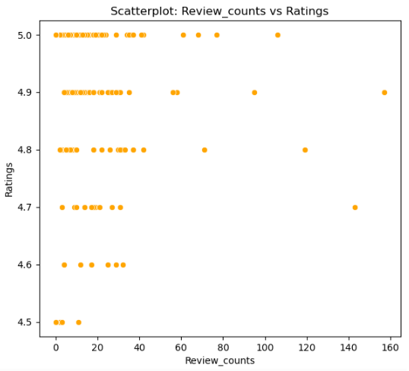
Reviews vs Ratings
Ratings remain consistently high (4.5–5.0) across all review counts.
Most vendors have less than 50 reviews, indicating newer or niche planners.
A few vendors with 100+ reviews stand out as popular and trusted.
Service quality appears consistent across the market.
Customers consider both ratings and reviews when selecting planners

Slide 10
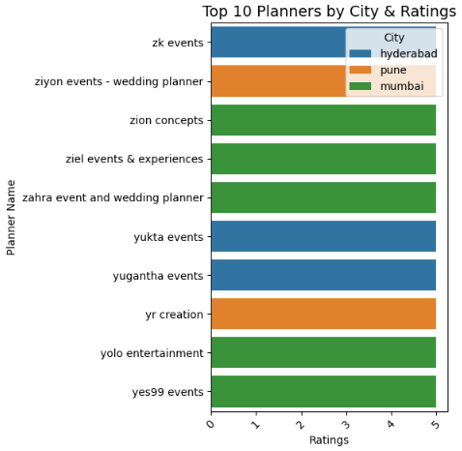
Correlation between Planners, City & Ratings
All top planners have high ratings of 5.
High-quality planners exist across all major cities.
Mumbai dominates the top-rated planners list.
Hyderabad also shows strong competition with multiple top performers.
Pune has fewer planners in the top 10 but maintains high service quality.
Overall, service standards are consistently high across cities.

Slide 11
Conclusion
The wedding planner market shows high overall service quality.
Most planners receive strong customer ratings, indicating satisfaction.
The market is largely budget-friendly, with limited premium pricing.
Customers prefer planners offering flexible and customizable services.
High ratings are maintained regardless of review volume.
Metro cities like Mumbai and Hyderabad lead in top-rated planners.
Data-driven analysis helps customers make informed planner choices.

Slide 12
Experiences and Challenges
Experiences
Gained hands-on experience in web scraping real-world data.
Learned to work with unstructured and messy data.
Improved skills in data cleaning, analysis, and visualization.
Understood how data supports business decision-making.
Challenges
Handling missing and inconsistent data from web scraping.
Cleaning text-based fields like prices, ratings, and reviews.
Converting raw data into analysis-ready format.
Choosing the right visualizations for clear insights.

Slide 13

THANK YOU

